Slide 1
Welcome
Awari
Notes:
https://www.youtube.com/watch?v=0O7_-_iA1cc

Slide 2
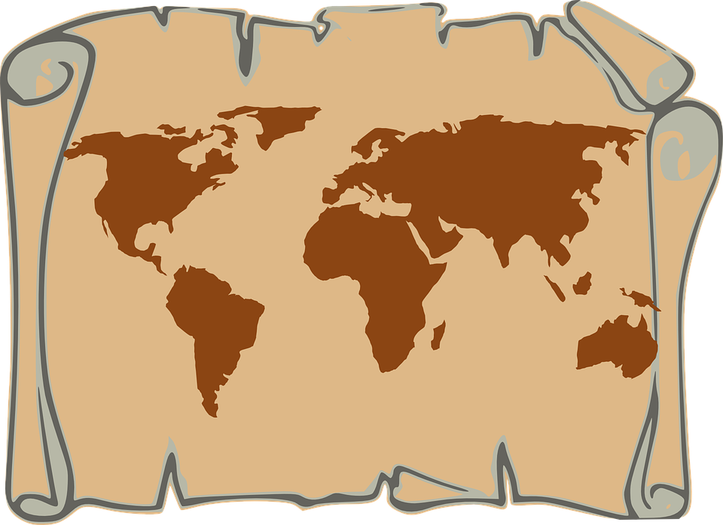
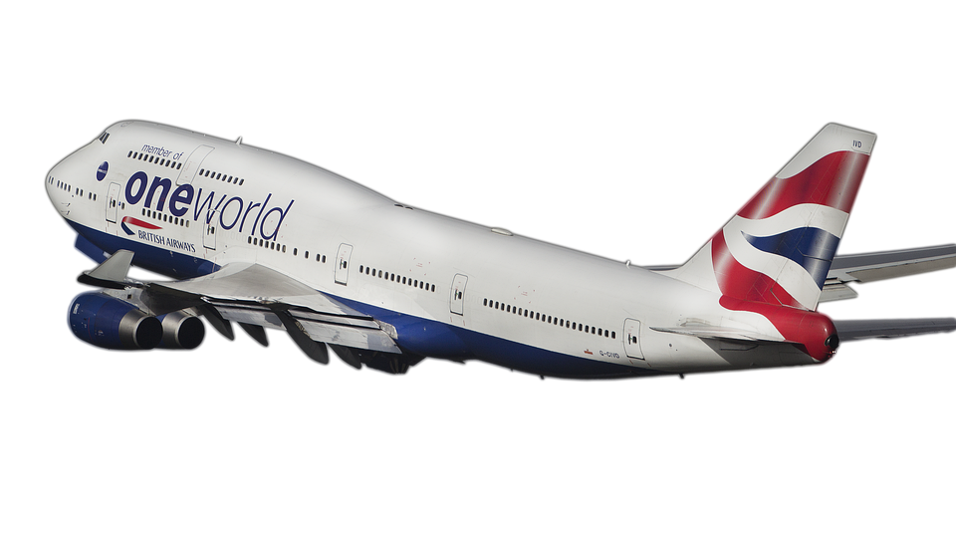
We’re going to…..
Nigeria

Slide 3
K
What do you know about Nigeria?
A country in Africa
Flag colors are green and white
People in Nigeria are called Nigerian people
It is hot in Nigeria
It’s one of the most populated countries in the world
There are a lot of cities in Nigeria
W
What do you want to know about Nigeria?
What holidays do they celebrate?
What type of art do they have?
What kind of foods to they eat?
What type of clothing do they wear?
L
What have you learned about Nigeria?
People in Nigeria celebrate New Years, Easter, and many other holidays.
Some people in Nigeria wear robes and tribal clothing. Girls wear skirts, boys can wear pants and shirts typical of what we would were in the United States.

Slide 4
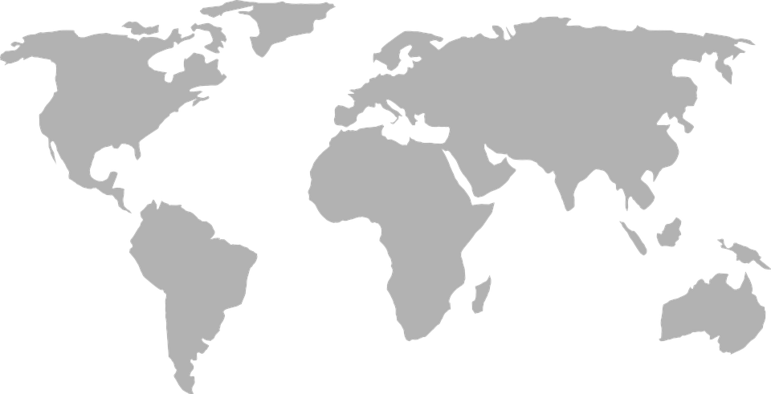


Cleveland, Ohio,
United States of America
Nigeria

Slide 5
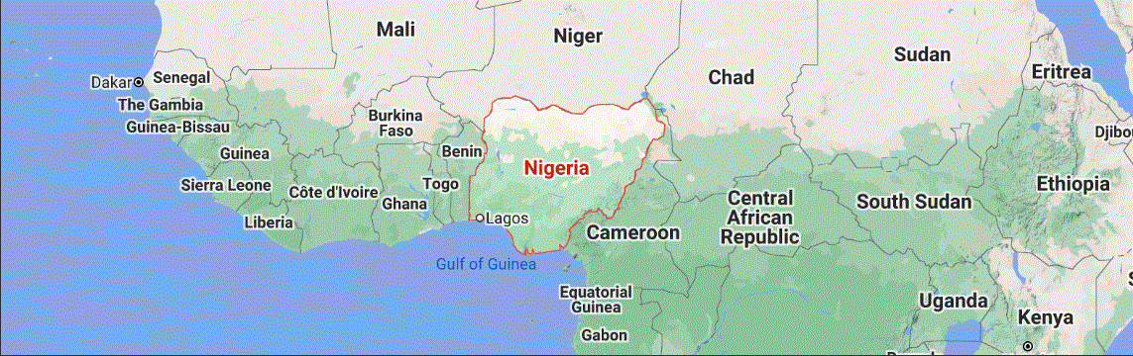
Nigeria is made up of 36 states. The federal capital territory is named Abuja.
The United States is made up of ______ states. Our federal capital territory is named _______________ _____.
50
Washington DC

Slide 6
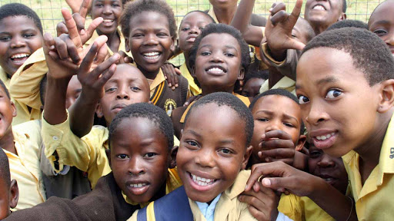
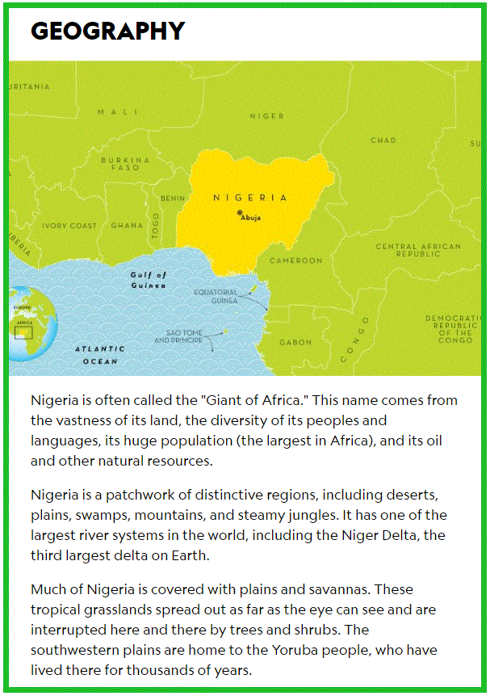

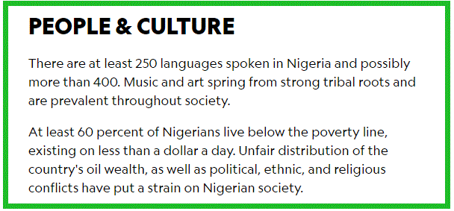
Road trip through Nigeria
Next, watch this video: CLICK HERE

Slide 7

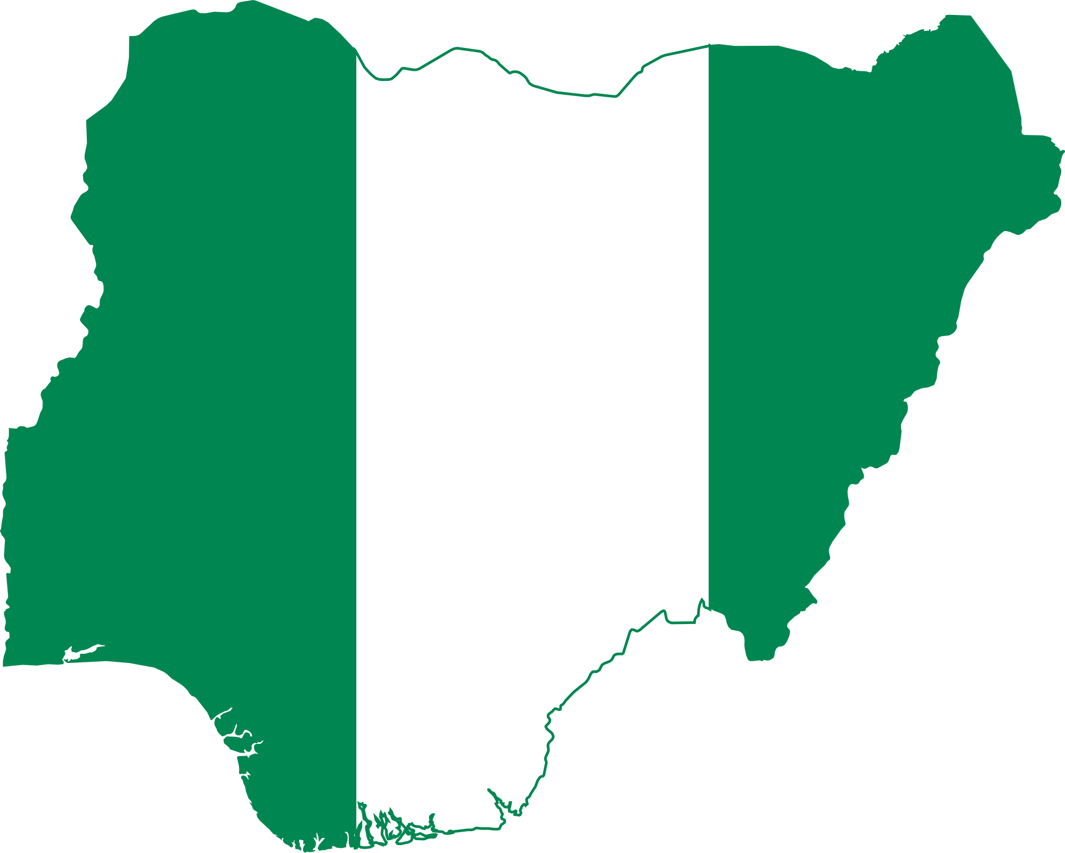
Using Chrome as your browser, launch Google Earth by going to: https://www.google.com/earth
Enter the following into the search bar: Abuja, Nigeria
From the aerial view, describe the landscape and surrounding area. What do you see from the street view? Compare and contrast Nigeria to the United States of America. What is the same and what is different?
Here are some National Parks to visit…
Erin-ljesha, Nigeria
Okomu National Park, Nigeria
Edumanom National Forest, Nigeria
Yankari National Park, Nigeria
Kainji National Park, Nigeria
Gashaka Gumti National Park, Nigeria
Want to see more of the country?
Check out these cities:
Enugu, Nigeria
Port Harcourt, Nigeria
Uyo, Nigeria
Benin City, Nigeria
Calabar, Nigeria
Lagos, Nigeria
Abeokuta, Nigeria
Ibadan, Nigeria
Want to see more of Abuja?
Take a trip to Zuma Rock, Abuja, Nigeria
Take a trip to Abuja National Mosuqe, Abuja, Nigeria
Drag the person icon to any blue line or dot on the map to see a street view of the area.

Slide 8

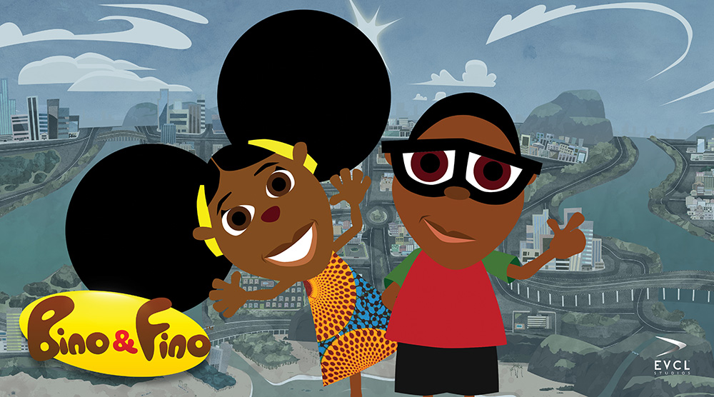
Why the Sky Is Far Away: A Nigerian Folktale
Bino and Fino: An African cartoon

Slide 9

Learn how to speak Yoruba
Click the picture below to watch the video

